Slide 1
A core Course on Modeling
Introduction to Modeling
0LAB0 0LBB0 0LCB0 0LDB0
c.w.a.m.v.overveld@tue.nl
v.a.j.borghuis@tue.nl
S.24

Slide 2
Execution phase: operate model
define
formulate
purpose
conceptualize
identify
entities
choose
relations
formalize
obtain
values
formalize
relations
execute
operate
model
obtain
result
conclude
present
result
interpret
result
Notes:
2

Slide 3
Cat.-II –space and dominance
Revisit optimization with multiple criteria:
Problems with lumping penalties Q=Σ_{i}w_{i}q_{i}
what are the values of w_{i} (trial and error)?
don’t add things that shouldn’t be added.
→ look for alternative approach, using dominance
Notes:
3

Slide 4
Cat.-II –space and dominance
Assume cat.-II quantities are ordinals:
Every axis in cat.-II space is ordered;
concept C₁ dominates C₂
iff, for all cat.-II quantities q_{i}, C₁.q_{i} is better than C₂.q_{i};
‘Being better’ may mean ‘<‘ (e.g., waste) or ‘>’ (e.g., profit);
http://www.morguefile.com/archive/display/765894
Notes:
4

Slide 5
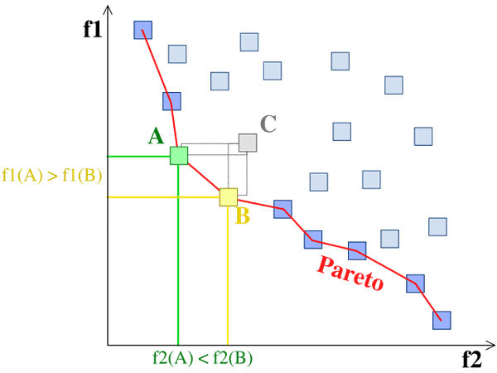
Cat.-II –space and dominance
A.f1<C.f1 and A.f2<C.f2, so
A dominates C
A.f2<B.f2 and B.f1<A.f1, so
B and A don’t dominate each other
f1 should be minimal (e.g., costs)
B.f1<C.f1 and B.f2<C.f2, so
B dominates C
f2 should be minimal (e.g., waste)
Notes:
5

Slide 6
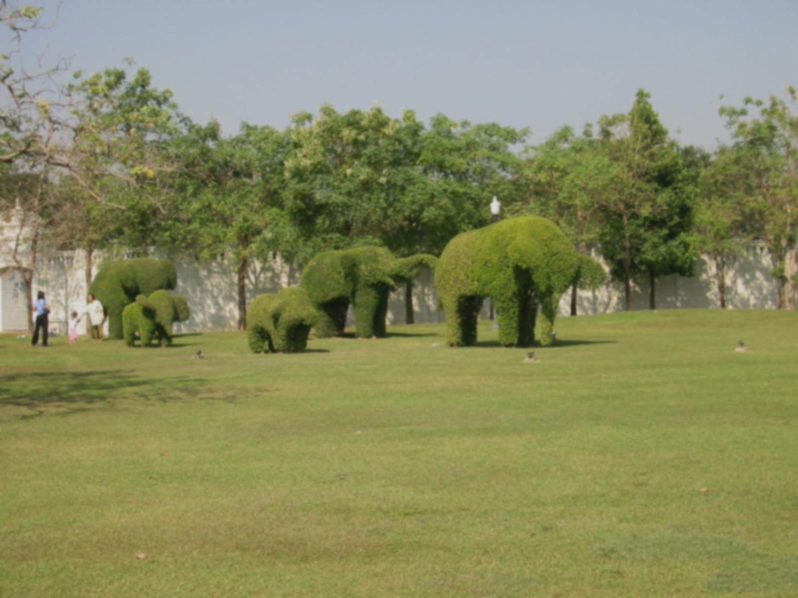
Cat.-II –space and dominance
Only non-dominated solutions are relevant → dominance allows pruning cat.-I space;
http://www.morguefile.com/archive/display/50363
Notes:
6

Slide 7
Cat.-II –space and dominance
Only non-dominated solutions are relevant → dominance allows pruning cat.-I space;
QUIZ
http://www.morguefile.com/archive/display/50363
Why does cat.-I space needs to be pruned?
Notes:
7

Slide 8
Cat.-II –space and dominance
Only non-dominated solutions are relevant → dominance allows pruning cat.-I space;
Nr. non-dominated solutions is smaller with more cat.-II quantities
http://www.morguefile.com/archive/display/50363
Notes:
8

Slide 9
Cat.-II –space and dominance
Only non-dominated solutions are relevant → dominance allows pruning cat.-I space;
Nr. non-dominated solutions is smaller with more cat.-II quantities
http://www.morguefile.com/archive/display/50363
QUIZ
Why do we have fewer non-dominated solutions with more cat.-II quantities?
Notes:
9

Slide 10
Cat.-II –space and dominance
Only non-dominated solutions are relevant → dominance allows pruning cat.-I space;
Nr. non-dominated solutions is smaller with more cat.-II quantities→ nr. of cat.-II quantities should be small (otherwise there are few dominated solutions).
http://www.morguefile.com/archive/display/50363
Notes:
10

Slide 11
Trade-offs and the Pareto front
In cat.-II space, dominated areas are half-infinite regions bounded by iso-coordinate lines/planes;
Solutions falling in one of these regions are dominated and can be ignored in cat.-I-space exploration;
Non-dominated solutions form the Pareto front.
Notes:
11

Slide 12
Trade-offs and the Pareto front
D
Cat.-II quantities f1 and f2 both need to be minimal. A and B are non-dominated, C is dominated. Of A and B, none dominates the other.
Notes:
12

Slide 13
Trade-offs and the Pareto front
D
Cat.-II quantities f1 and f2 both need to be minimal. Solution D would dominate all other solutions – if it would exist.
Notes:
13

Slide 14
Trade-offs and the Pareto front
Relevance of Pareto-front:
it bounds the achievable part of cat.-II space;
solutions not on the Pareto front can be discarded.
Notes:
14

Slide 15
Trade-offs and the Pareto front
Relevance of Pareto-front:
it exists for any model function, although in general it can only be approximated by sampling the collection of solutions.
Notes:
15

Slide 16
Trade-offs and the Pareto front
Relevance of Pareto-front:
it defines two directions in cat.-II space:
Notes:
16

Slide 17
Trade-offs and the Pareto front
direction of absolute improvement
http://cdn.morguefile.com/imageData/public/files/a/alvimann/preview/fldr_2010_03_23/file3831269347533.jpg
Relevance of Pareto-front:
it defines two directions in cat.-II space: the direction of absolute improvement / deterioration,
Notes:
17

Slide 18
Trade-offs and the Pareto front
direction of absolute deterioration
http://cdn.morguefile.com/imageData/public/files/a/alvimann/preview/fldr_2010_03_23/file3831269347533.jpg
Relevance of Pareto-front:
it defines two directions in cat.-II space: the direction of absolute improvement / deterioration,
Notes:
18

Slide 19
Trade-offs and the Pareto front
tangent to the pareto-front: trade-offs
http://cdn.morguefile.com/imageData/public/files/a/alvimann/preview/fldr_2010_03_23/file3831269347533.jpg
Relevance of Pareto-front:
it defines two directions in cat.-II space: the direction of absolute improvement / deterioration, and the plane perpendicular to this direction which is tangent to the Pareto front, which represents trade-offs between cat.-II quantities.
Notes:
19

